Slide 1
CSCIU 210 Computer Organization AKM Jahangir A Majumder, PhD
Fall 2018 - Lecture 8
September 12, 2018
Note: Some slides are adapted from those used by previous instructors and some slides include figures from the textbook.

Slide 2
Review and Learning Outcomes
We will continue to cover fundamental combinational digital logic block
Will discuss:
Number Systems
Fractional Number Systems
We will begin to cover how to do math in the binary format and how to implement it in hardware
Homework 2 will post on blackboard soon which is due on Wednesday, September 19 at the beginning of the lecture (Hard Copy)
We will have quiz 2 on Friday, September 21, which will cover lectures 5-9

Slide 3
More examples
F = (a AND NOT(b)) OR (b AND NOT(c))
F = a AND (s OR d)
2
1
3
1
2
a
a
b
s
F
F
d
c
(
a
)
a
a
(
b
)
DeMorgan’s Law
(a + b)’ = a’b’
(ab)’ = a’ + b’
Start from the output, work back towards the inputs

Slide 4
Exercises: Check for Yourself
Draw the logic circuit diagram for F=A+B’⋅C.
Determine the truth table for the following logic equations: F=A’⋅B⋅C+A’⋅B⋅C’+A⋅C.
Write the logic equation for the following circuit diagram
A
B
C
D
E

Slide 5
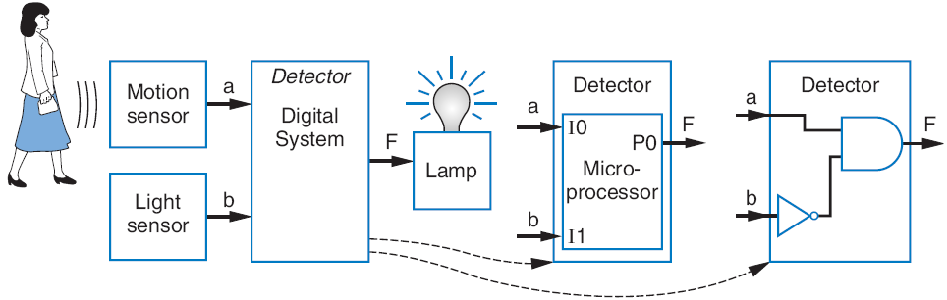
Building Circuits Using Gates
Example
Turn on lamp (F=1) when motion sensed (a=1) and no light (b=0)
F = a AND NOT(b)
Build using logic gates, AND and NOT, as shown

Slide 6

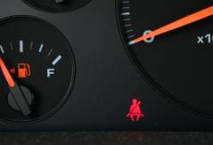
Example: Seat Belt Warning Light System
Design circuit for warning light
Sensors
s=1: seat belt fastened
k=1: key inserted
Capture Boolean equation
seat belt not fastened, and key inserted
Convert equation to circuit
Timing diagram illustrates circuit behavior
We set inputs to any values
Output set according to circuit
w = NOT(s) AND k
a
Inputs
k
1
0
s
1
0
a
Outputs
1
w
0
time

Slide 7
Complement of a Function
Commonly want to find complement (inverse) of function F
0 when F is 1; 1 when F is 0
Use DeMorgan’s Law repeatedly
Note: DeMorgan’s Law defined for more than two variables, e.g.:
(a + b + c)' = (abc)'
(abc)' = (a' + b' + c')
Complement of f = w'xy + wx'y'z'
f ' = (w'xy + wx'y'z')'
f ' = (w'xy)'(wx'y'z')' (by DeMorgan’s Law)
f ' = (w+x'+y')(w'+x+y+z) (by DeMorgan’s Law)
Can then expand into sum-of-products form

Slide 8
What is a Digital System?
A digital system processes and stores information using binary digits (bits). Binary digits can have only one of two values.
Commonly encountered in everyday life
Computers, CD & DVD players, digital music players, HDTV, cell phones, etc.
When dealing with digital information, it is convenient to use number systems based on powers of 2 (instead of the decimal system, which is base 10).

Slide 9
Number Systems
Base or radix of a number system
Specifies how many symbols are used to represent numbers. It’s the size of the “number alphabet”.
Examples
Base 2 (binary): 0, 1
Base 10 (decimal): 0, 1, 2, 3, 4, 5, 6, 7, 8, 9
Base 16 (hexadecimal, or hex): 0, 1, 2, 3, 4, 5, 6, 7, 8, 9, A, B, C, D, E, F
Notation: Specify the base of the number system as a subscript after the number. If there is no subscript, base 10 is assumed. Example: 101₂, 101₁₀, and 101₁₆ are all different numbers!

Slide 10
Number Systems – Representation
Positive radix, positional number systems
A number with radix r is represented by a string of digits: A_{n - 1}A_{n - 2} … A₁A₀ . A₋ ₁ A₋ ₂ … A_{- m + 1} A_{- m} in which 0 ≤ A_{i} < r and . is the radix point.
The string of digits represents the power series:
(
)
(
)
i = n - 1
j = - 1
∑
+
∑
(Number)_{r}
=
A
r
i
A
r
j
i
j
i = 0
j = - m
(Integer Portion)
(Fraction Portion)
+

Slide 11
Number Systems – Examples
 | General | Decimal | Binary
Radix (Base) | r | 10 | 2
Digits | 0 => r - 1 | 0 => 9 | 0 => 1
0 1 2 3 Powers of 4 Radix 5 -1 -2 -3 -4 -5 | r⁰ r¹ r² r³ r⁴ r⁵ r ⁻¹ r ⁻² r ⁻³ r ⁻⁴ r ⁻⁵ | 1 10 100 1000 10,000 100,000 0.1 0.01 0.001 0.0001 0.00001 | 1 2 4 8 16 32 0.5 0.25 0.125 0.0625 0.03125

Slide 12
Binary Numbers
Binary (base 2) Numbers
The basis for digital design
Simplifies design
Easy storage
Any number of instructions can be represented in terms of two symbols, typically 0 and 1
Physically, 0 and 1 are often represented by one of two voltages (for example, 0 V and 5 V).
0 , 1 may be used to represent one of two states, such as:
“false”, “true”
“low”, “high”
“off”, “on”

Slide 13
Binary Numbers
Some terminology and units
Bit (b): A single binary digit
Nib: 4 bits
Byte (B): 8-bits
Word: A group of bits of any size (often 4 bytes).
kb: 2¹⁰ bits = 1024 bits (kB = 2¹⁰ bytes)
Mb: 2²⁰ bits =1,048,576 bits (MB = 2²⁰ bytes)
Gb: 2³⁰ bits = 1,073,741,820 bits (GB = 2³⁰ bytes)
MSB: Most significant bit (leftmost digit of binary #)
LSB: Least significant bit (rightmost digit of bin. #)

Slide 14

Binary Numbers
Number of Digits (bits) | Digit Combinations | Number of Combinations
1 | 0, 1 | 2
2 | 00, 01, 10, 11 | 4
3 | 000,001,010,011, 100,101,110,111 | 8
4 | 0000,0001,0010,0011, 0100,0101,0110,0111, 1000,1001,1010,1011, 1100,1101,1110,1111 | 16
10 | 0000000000,0000000001, … | 1024
N | … | 2^{N}

Slide 15
Binary and Decimal Numbers
The binary number system is used in the computer mainly because the computer uses binary logic circuit.
The decimal number system is used by many different cultures probably because a normal human being have 10 fingers.
Since computers can only deal with binary numbers and we are most familiar with decimal numbers, it is necessary for us to learn how to convert a number between these two bases.

Slide 16
Binary to Decimal Conversion
Binary Number:
···b₃b₂b₁b₀ (each bit b_{i} is 0 or 1)
Its decimal value is:
b₀×2⁰ + b₁×2¹ + b₂×2² + b₃×2³ + ···
= b₀×1 + b₁×2 + b₂×4 + b₃×8 + ···
Examples: 1110₂ Decimal value is:
1111₂ Decimal value is:
110010₂ Decimal value is:
111111₂ Decimal value is:
14
15
50
63
Check your understanding:
N bits → 2^{N} combinations → decimal numbers 0, 1, 2, 3, …, 2^{N} - 1
The largest number: 11…11₂ = 2^{N}-1 (decimal)
N bits, all ones

Slide 17
Converting Binary to Decimal
To convert to decimal, use decimal arithmetic to form Σ (digit × respective power of 2).
Example 2: Convert 11010₂ to N₁₀:
N= 1×2⁴+1×2³+0×2²+1×2¹+0×2⁰=26
Example 3: Convert 10.11₂ to R₁₀
R= 1×2¹+0×2⁰+1×2⁻¹+1×2⁻²=2.75
Notes:
Powers of 2: 43210
11010₂ =>
1 X 2⁴ = 16
+ 1 X 2³ = 8
+ 0 X 2² = 0
+ 1 X 2¹ = 2
+ 0 X 2⁰ = 0
26₁₀

